Slide 1
Basic System presentation
Nolan Luckett
04/04/18

Slide 2
Introduction
The Zybo board has been programmed to record and play back audio at the press of a button.
Uses an I2S IP and an I2C on the PS to interact with the Zybo’s audio codec.

Slide 3
Audio Codec
The Zybo’s audio codec features 2x 24 bit ADCs and 2x 24 bit DACs
The sample rate is configurable from 8 kHz to 96 kHz
A mute signal is available for control via GPIO
It must be enabled and configured by I2C before use

Slide 4
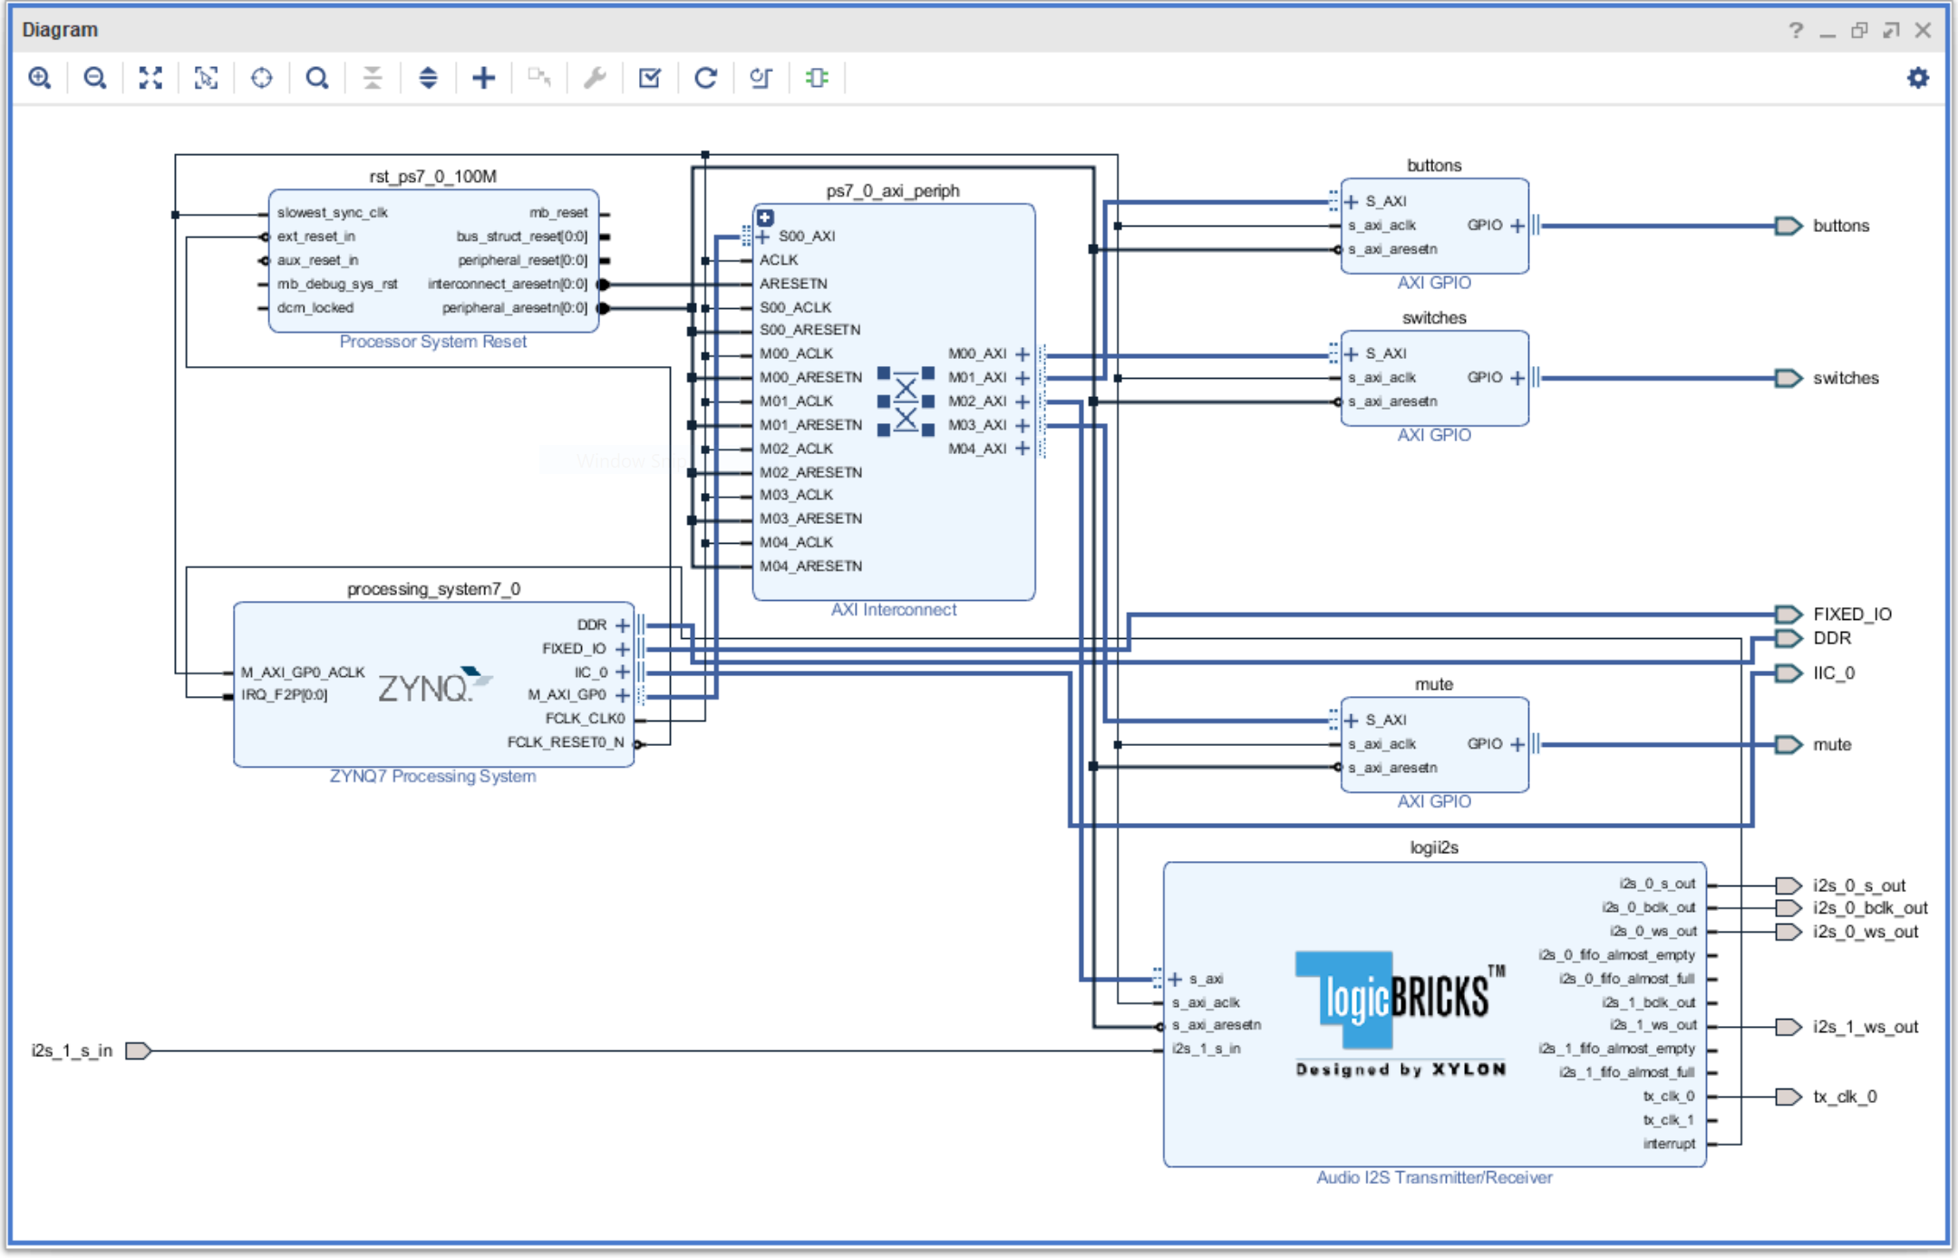
Hardware Design
The hardware platform is based on Lab 2
The buttons IP is used to initiate audio recording and playback
An additional AXI GPIO “mute” is used to mute the audio codec
The LOGII2S IP is used to transfer audio data with the audio codec

Slide 5
Logiblocks i2s ip
I2S (Inter-IC Sound) is a interface standard used for audio data transfer in embedded systems.
It uses 1+ data lines, a bit clock, and a channel select (L/R). A master clock is also shared with the audio codec.
Audio data is transmitted and received by FIFOs. The state of the FIFOs is indicated by an interrupt line and a set of interrupt state registers

Slide 6
Playback with the I2S IP
Set the channel’s prescale value to obtain the appropriate bit rate.
Set the channel’s word select values.
Fill the FIFO with data.
Clear the interrupt mask register.
Reset the interrupt sense register by writing ‘1’.
Enable data transfer by writing a ‘1’ to the enable bit in the control register.
Wait for the FIFO almost empty interrupt to occur.
Repeat from step 3.

Slide 7
Recording with the i2s IP
Set the channel’s prescale value to obtain the appropriate bit rate.
Set the channel’s word select values.
Clear the interrupt mask register.
Reset the interrupt sense register by writing ‘1’.
Enable data transfer by writing a ‘1’ to the enable bit in the control register.
Wait for the FIFO almost full interrupt to occur.
Read from the FIFO.
Repeat from step 3.

Slide 8
Challenges
Audio Distortion
The maximum size of the LOGII2S FIFOs only allows for a small fraction of a second worth of data to be present at a time; so multiple reads are necessary
It sounds like samples are being dropped, so these FIFO reads/writes probably are not happening quickly enough

Slide 9
Next stage
Clean up the audio quality
Add audio processing IP
Stream the data over the ethernet connector

Slide 10
References
https://reference.digilentinc.com/reference/programmable-logic/zybo/reference-manual

